Slide 1
ILLINOIS JUDICIAL BRANCH
STRATEGIC
AGENDA
2019-2022

Slide 2
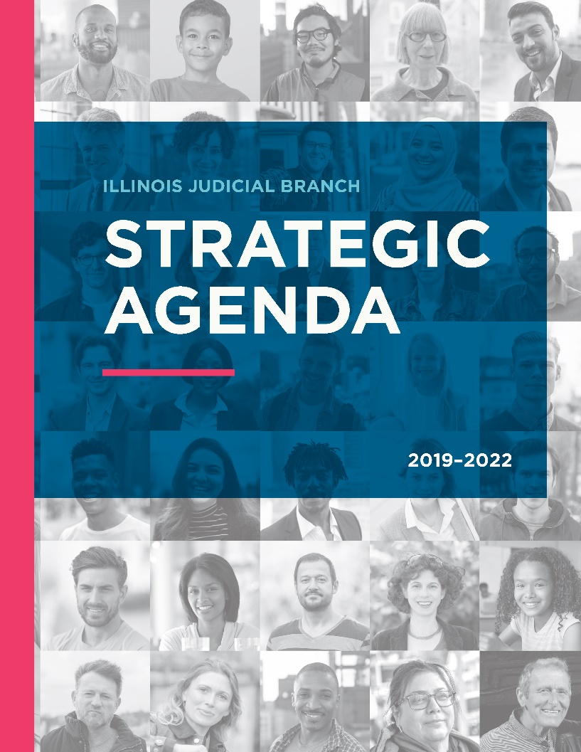
ILLINOIS JUDICIAL BRANCH
Strategic Agenda
2019-2022

Slide 3
ILLINOIS CONSTITUTION
Article VI, Section 17
“The Supreme Court shall provide by rule for an annual judicial conference to consider the work of the courts and to suggest improvements in the administration of justice…”

Slide 4
October 2018, the Supreme Court amended Supreme Court Rule 41 to reconstitute the membership of the Illinois Judicial Conference
ILLINOIS JUDICIAL CONFERENCE
Gave the Illinois Judicial Conference a new responsibility—it would be “the body to strategically plan for the Illinois Judicial Branch.”

Slide 5
Is a multi-disciplinary, diverse and inclusive body
ILLINOIS JUDICIAL CONFERENCE
29 members—15 judges and 14 non-judges
Chair is the Current Chief Justice of the Illinois Supreme Court

Slide 6
Judicial officer members designated by position:
ILLINOIS JUDICIAL CONFERENCE
Judicial Officer Members
Chief Judge of the Circuit Court of Cook County
Chair and Vice-Chair of the Conference of Chief Circuit Judges
Other judicial officers appointed by the Supreme Court:
A Justice of the Supreme Court
At least one appellate court justice

Slide 7
Three judges from the First Judicial District and one from each of the other four Judicial Districts
ILLINOIS JUDICIAL CONFERENCE
Judicial Officer Members
A judge who is on the Illinois Judicial College Board of Trustees
A judge who is a member of the Access to Justice Commission

Slide 8
Designated by position: AOIC Director
ILLINOIS JUDICIAL CONFERENCE
Non-Judge Members
Appointed by the Supreme Court:
Three court clerks (at least two being circuit clerks)
Three trial court administrators
Three Illinois attorneys
Three public members
A non-judge involved in the judicial branch

Slide 9
Deliberating in many voices, but governing in one
WHY STRATEGIC PLANNING?
Being anticipatory; planning for the future, focusing on strategies to meet future needs
Open and regular communication with all those working within the branch and with justice partners
Basing decisions on statewide needs while recognizing the needs of judicial circuits to adopt policies
Assessing and evaluating on a regular basis how well we are achieving statewide goals and policies
Notes:
Being anticipatory, planning for the future, focusing on strategies to meet future needs Cornerstone of strategic planning-communicating openly and regularly with all those working within the branch and with justice partners Involving judges, administrators, clerks and justice partners in developing and implementing policies Basing decisions on statewide needs, priorities, goals and values, while at the same time recognizing the needs of judicial circuits to adopt policies, which may differ but are not in conflict with statewide policies Assessing and evaluating on a regular basis how well we are achieving statewide goals and policies

Slide 10
MISSION
To protect the rights and liberties of all by providing equal access to justice, resolving disputes, and upholding the rule of law pursuant to the powers and duties entrusted to us by the Illinois Constitution.
Notes:
The Judicial Conference, after careful thought and much deliberation, crafted in the Strategic Agenda the first ever vision statement for the branch. A vision statement is visionary, inspirational and addresses the questions what will the branch look like in the future? What will the branch be doing in the future?

Slide 11
VISION
To be trusted and open to all by being fair, innovative, diverse, and responsive to changing needs.
Notes:
The Judicial Conference, after careful thought and much deliberation, crafted in the STRATEGIC AGENDA the first ever mission statement for the branch. A mission statement addresses the questions of what is the branch’s purpose? Why does it exist?

Slide 12
CORE VALUES
F.A.I.R
FAIRNESS- impartial in our actions, decisions, and treatment of all.
ACCOUNTABILITY- responsible and answerable for our conduct and performance, and transparent in the use of public resources.
INTEGRITY- honest, trustworthy, and committed to the highest ethical and professional standards.
RESPECT- treat all with dignity, courtesy, and understanding.
Notes:
The Judicial Conference, after careful thought and much deliberation, identified core values of the branch. Core values are beliefs, ethics, a code of behaviors to guide our daily actions.

Slide 13
5 STRATEGIC GOALS
1. Accessible Justice & Equal Protection Under the Law
2. Procedural Fairness, Timeliness, & Operational Efficiency
3. Professionalism & Accountability Throughout the Judicial Branch
4. Understanding of & Confidence in the Judicial Branch
5. Sufficient Funding & Effective Use of Judicial Branch Resources
Notes:
The STRATEGIC AGENDA provides a strategic plan for the branch for a three year time period, October 2019 through October 2022. There are five strategic focus areas identified to be addressed which are called Strategic Goals. These Strategic Goals are loft, high level goals for the branch.
In the STRATEGIC AGENDA the Judicial Conference has identified between four and seven strategies to achieve each strategic Goal. The Judicial Conference has adopted a one-year Operational Plan for the first year of implementation.

Slide 14
15 Strategic Initiatives to be completed within the first year of implementation
2019-2020 OPERATIONAL PLAN
8 new multi-disciplinary Task Forces created to take on one or more Strategic Initiatives:
Court Data & Performance Measures Task Force
Court Access & Dispute Resolution Task Force
Judicial Administration Task Force
Website Task Force
Public Relations Task Force
Weighted Caseload Study Task Force
Court Funding Task Force
Cost of Supervision/Detention Task Force
Notes:
15 Strategic Initiatives (specific tasks) assigned to be completed within the first year of implementation

Slide 15
2019-2020 OPERATIONAL PLAN
Strategic Initiatives were assigned to these existing bodies within the branch:
Commission on Access to Justice
Conference of Chief Circuit Judges
Judicial College Board of Trustees
Commission on Professionalism
The 2019-2020 Operational Plan can be viewed in its entirety on the Illinois Supreme Court’s Website

Slide 16
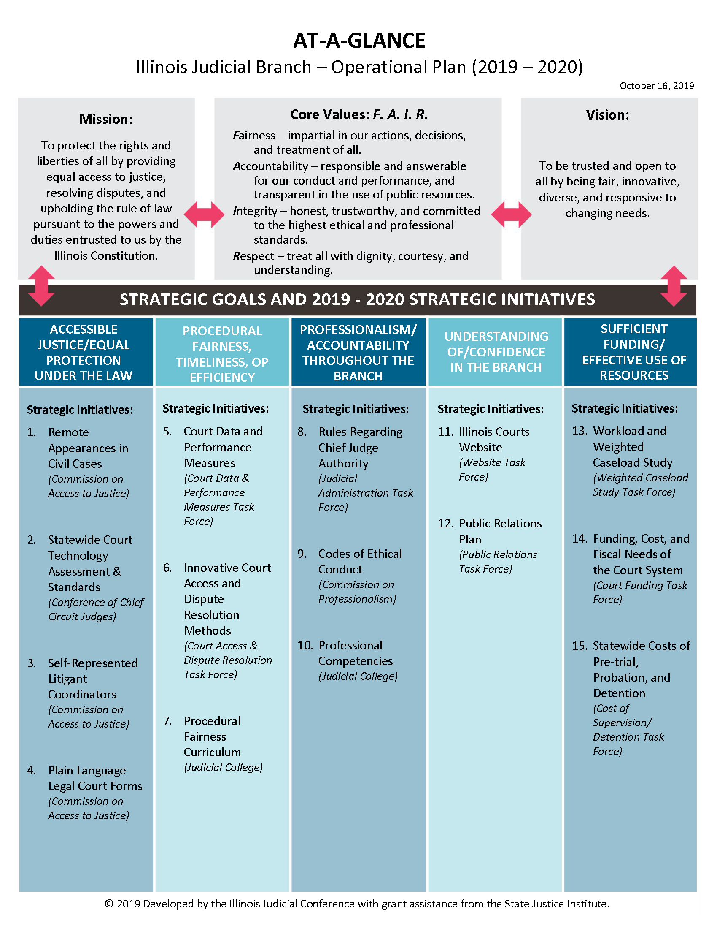
THE BLUEPRINT FOR THE FUTURE
The Agenda and Operational Plan can be viewed on the Illinois Supreme Court’s Website

Slide 17
THANK YOU!
Questions?

